Slide 1
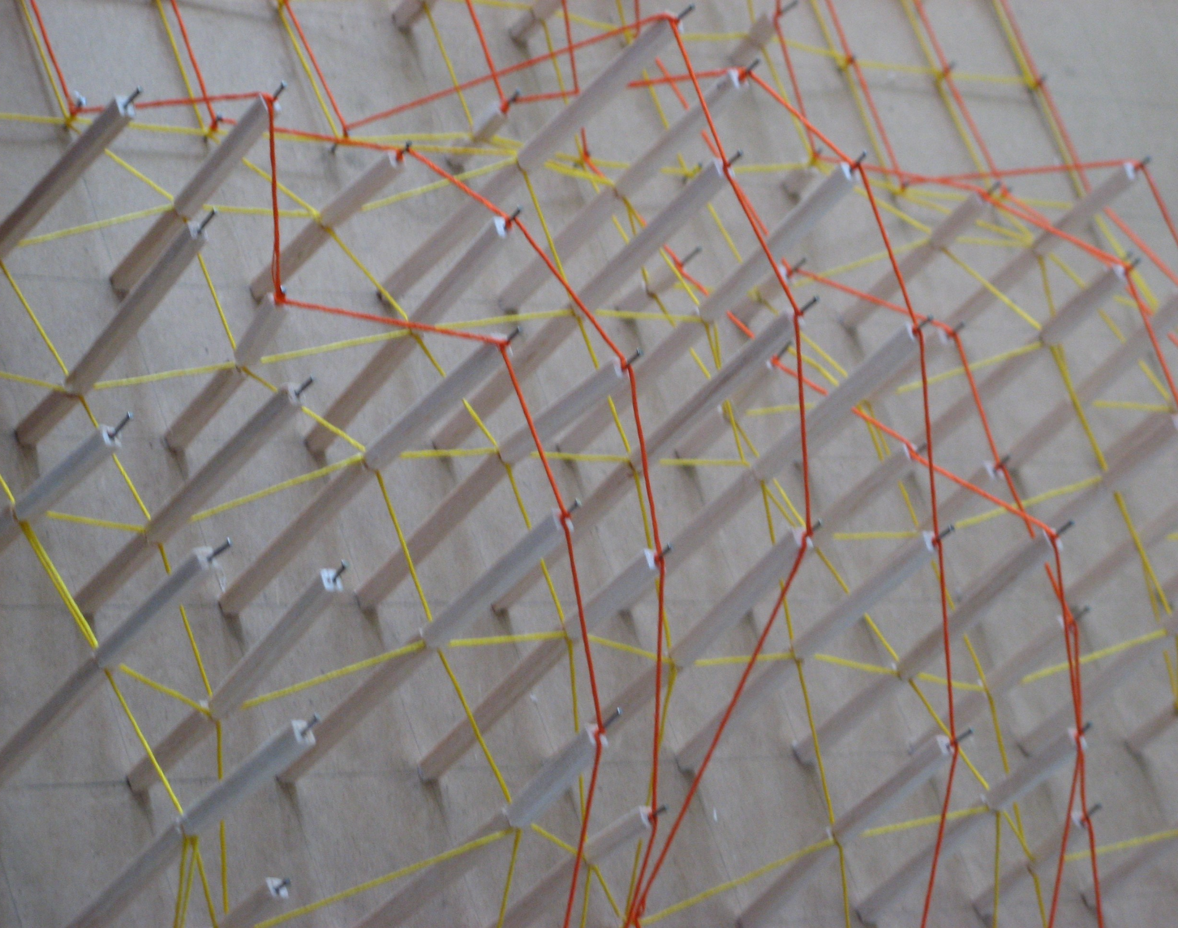
TACTILE PROGRAMMING:
'Material Computing' For Architectural Design
Phil Langley
with Students from School of Architecture, University of Sheffield

Slide 2
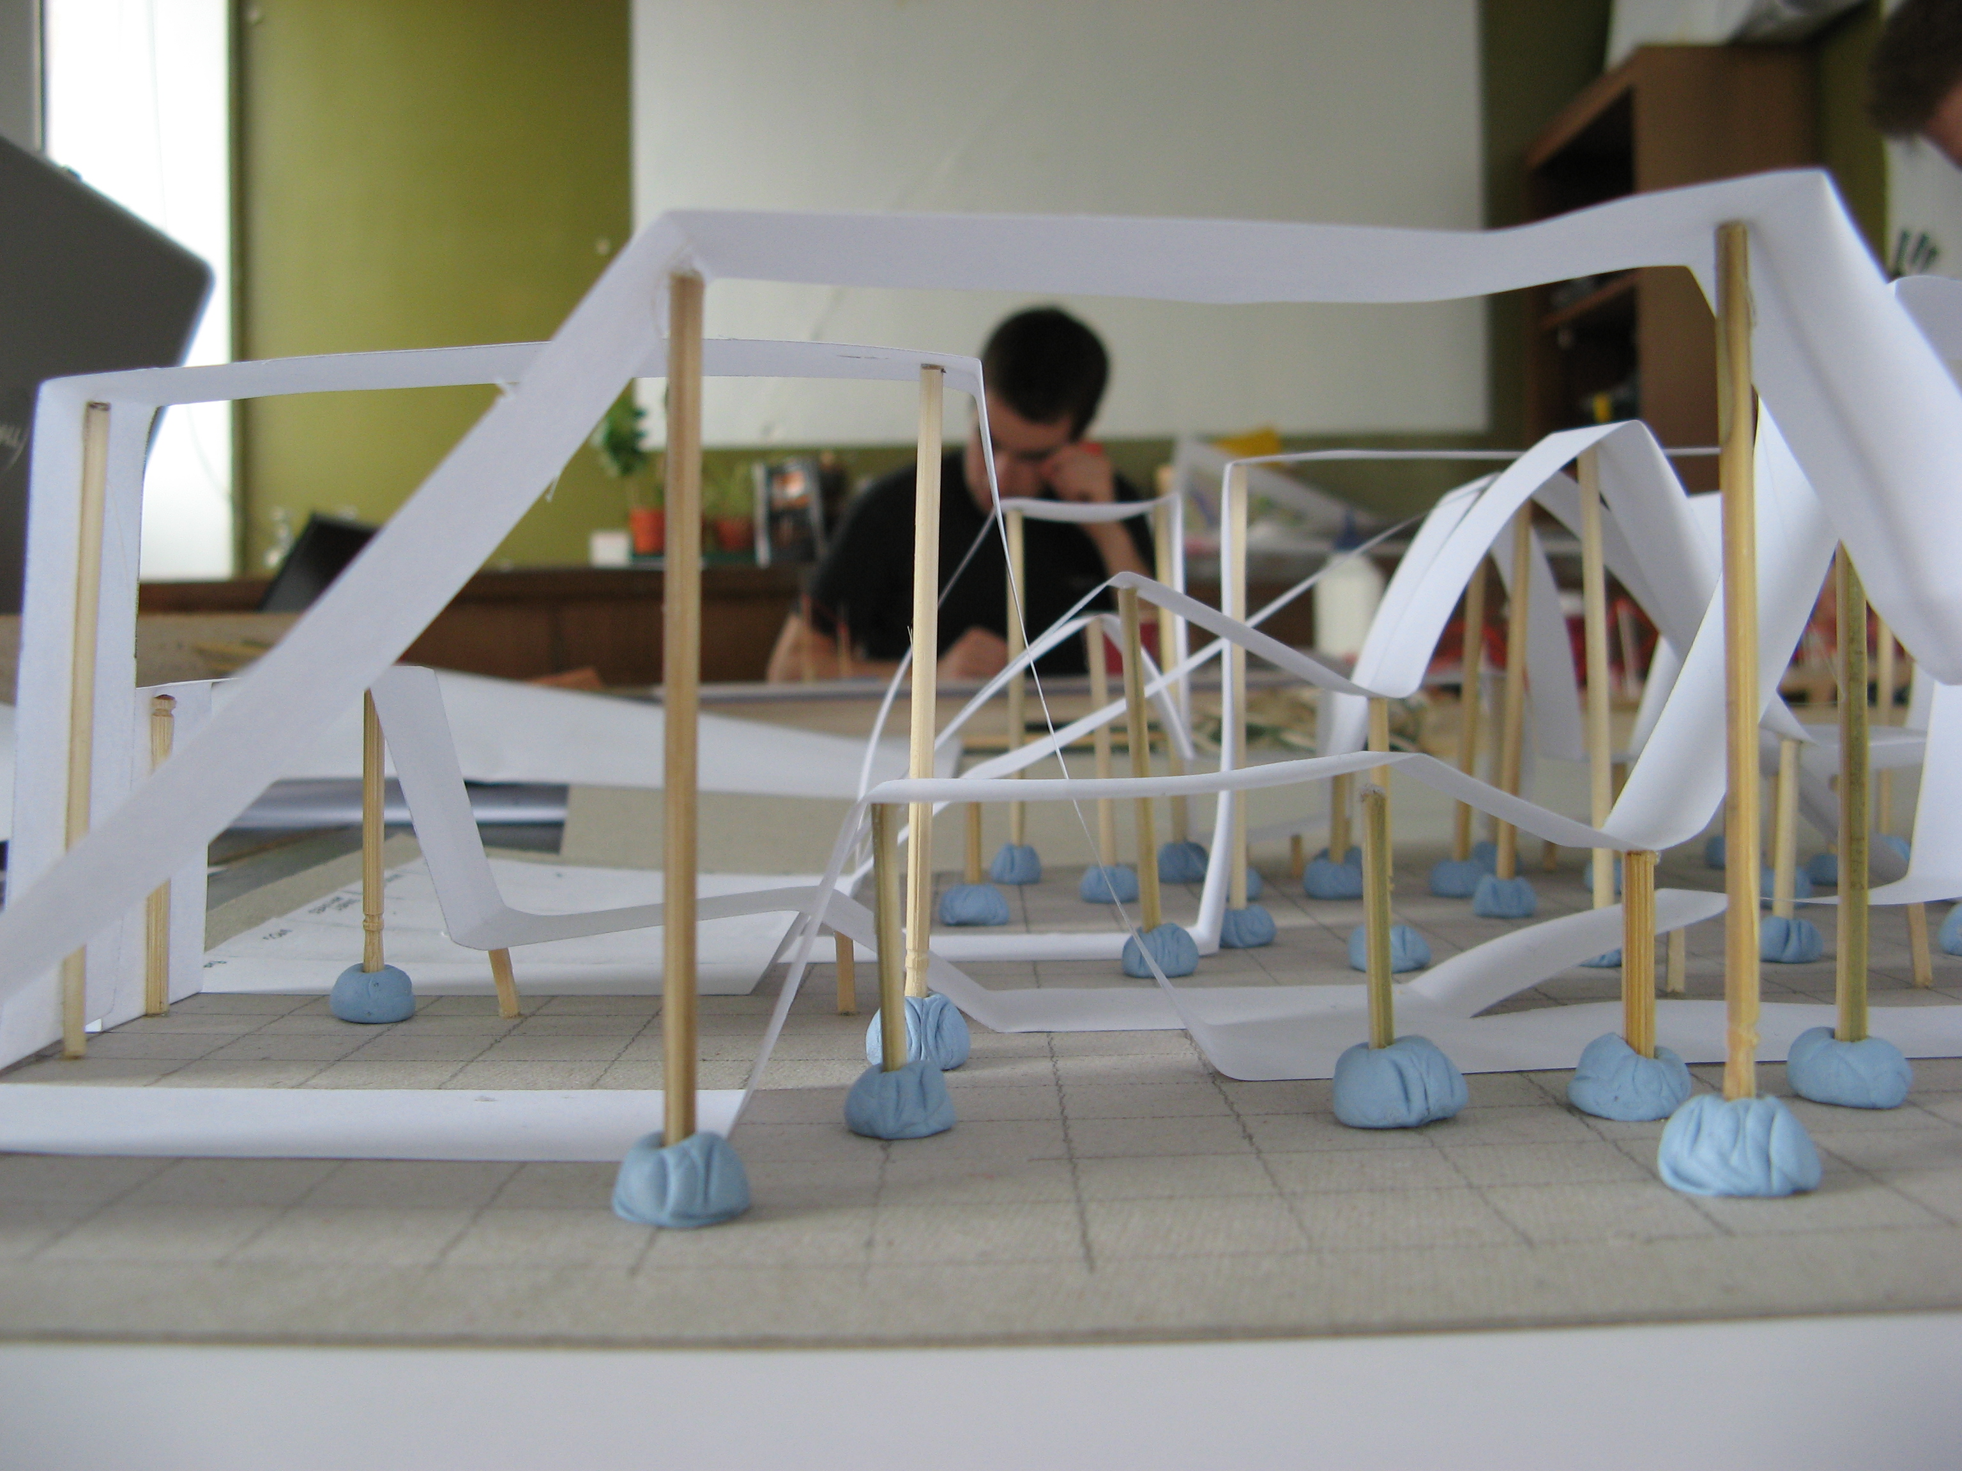

Slide 3
Algorithms as an explicit records of process
- - - - - - - - - - - - - - - - - - - - - - - - - - - - - - - - - - - - - - - - - -
Simulations as open experiments
- - - - - - - - - - - - - - - - - - - - - - - - - - - - - - - - - - - - - - - - - -
Interfaces as models of involvement

Slide 4
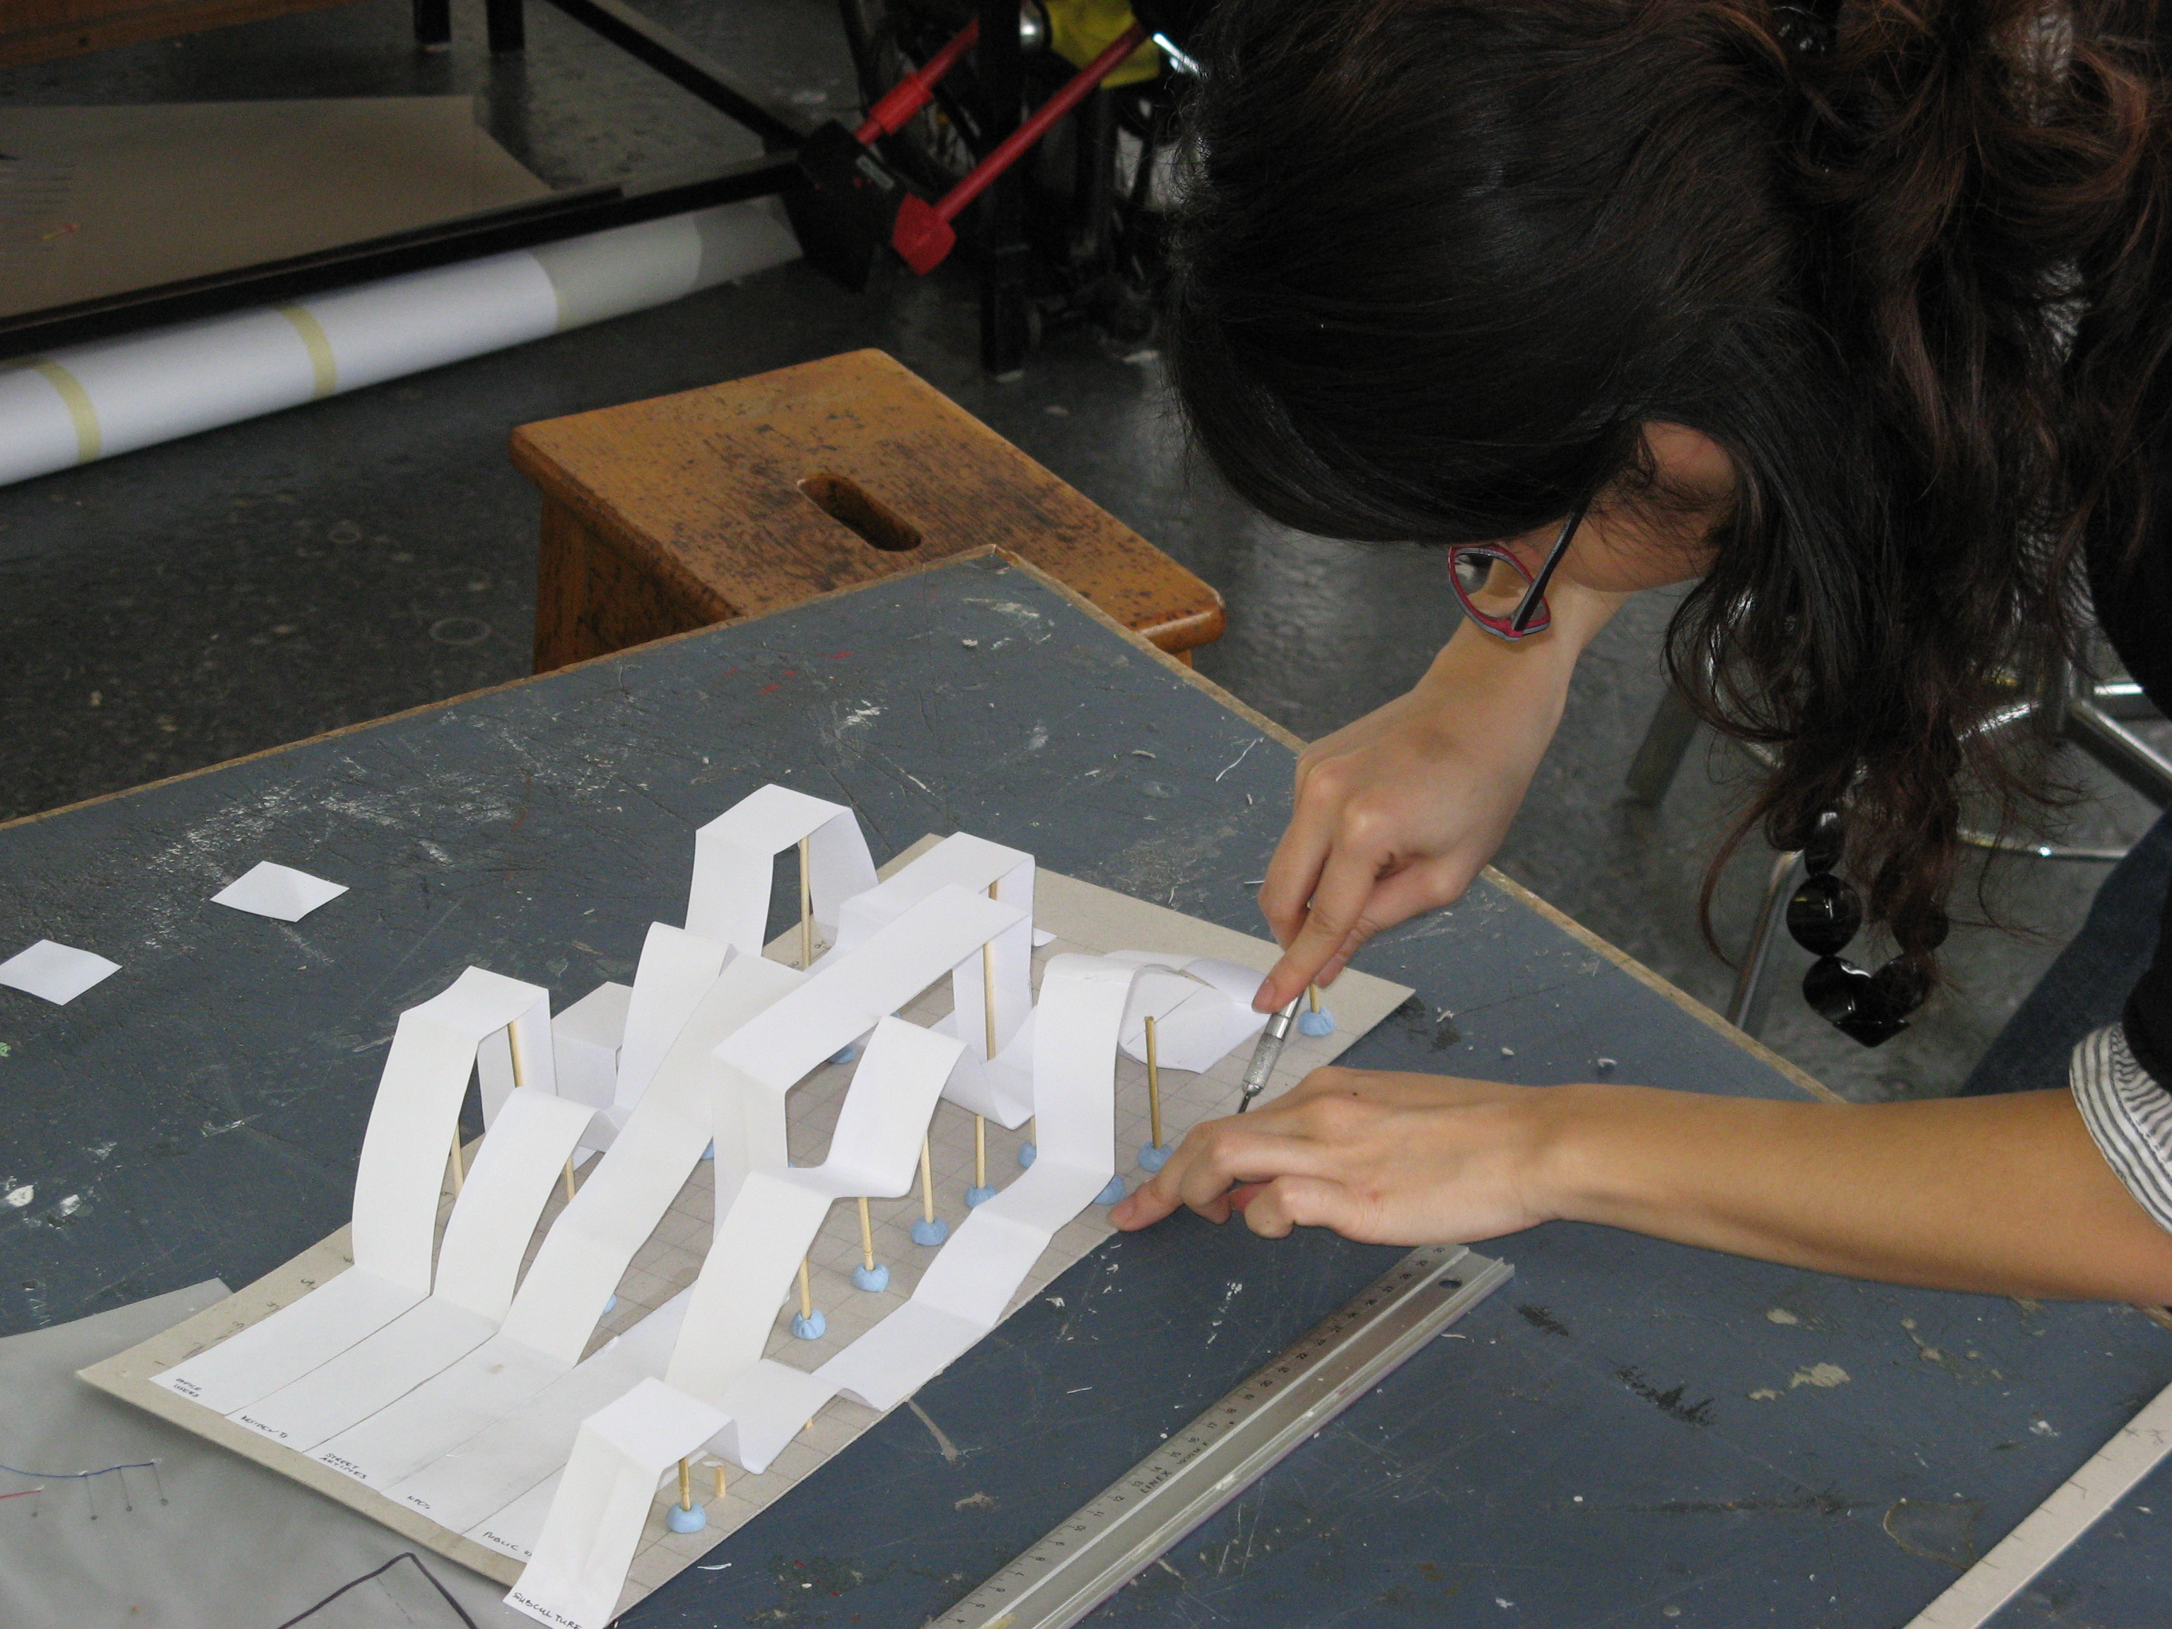
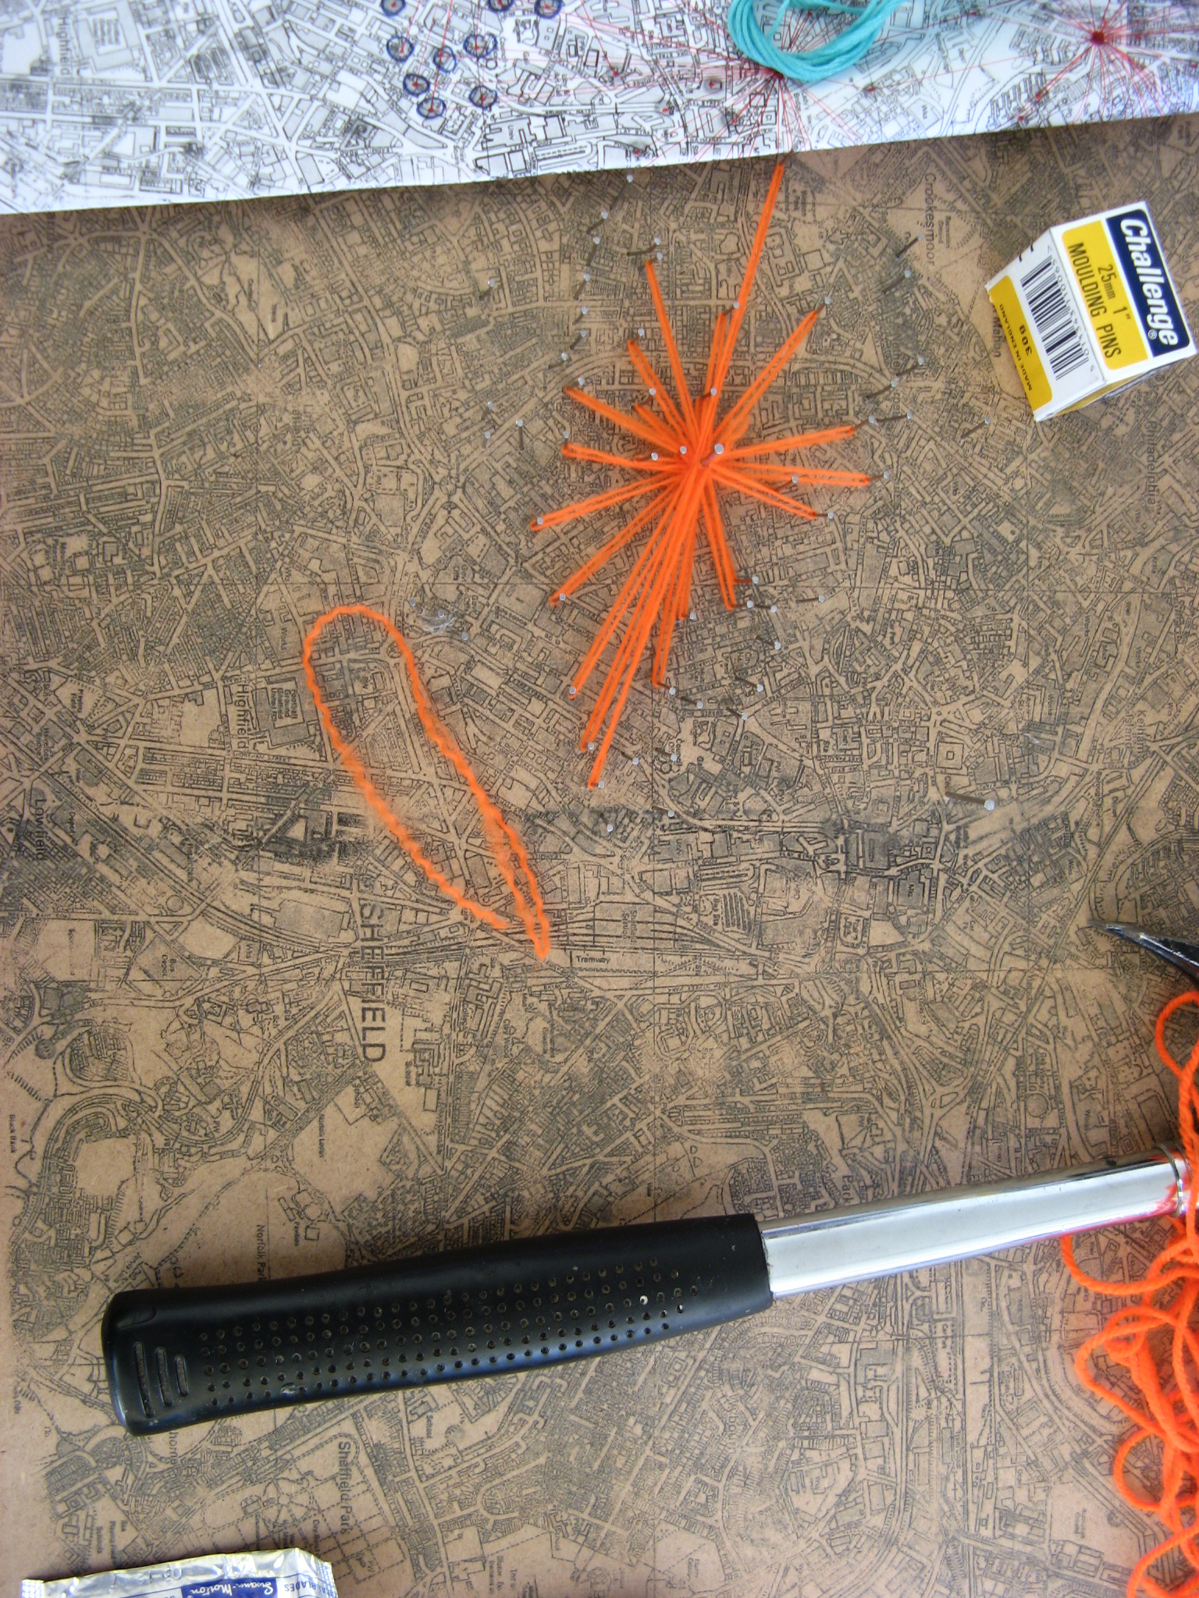
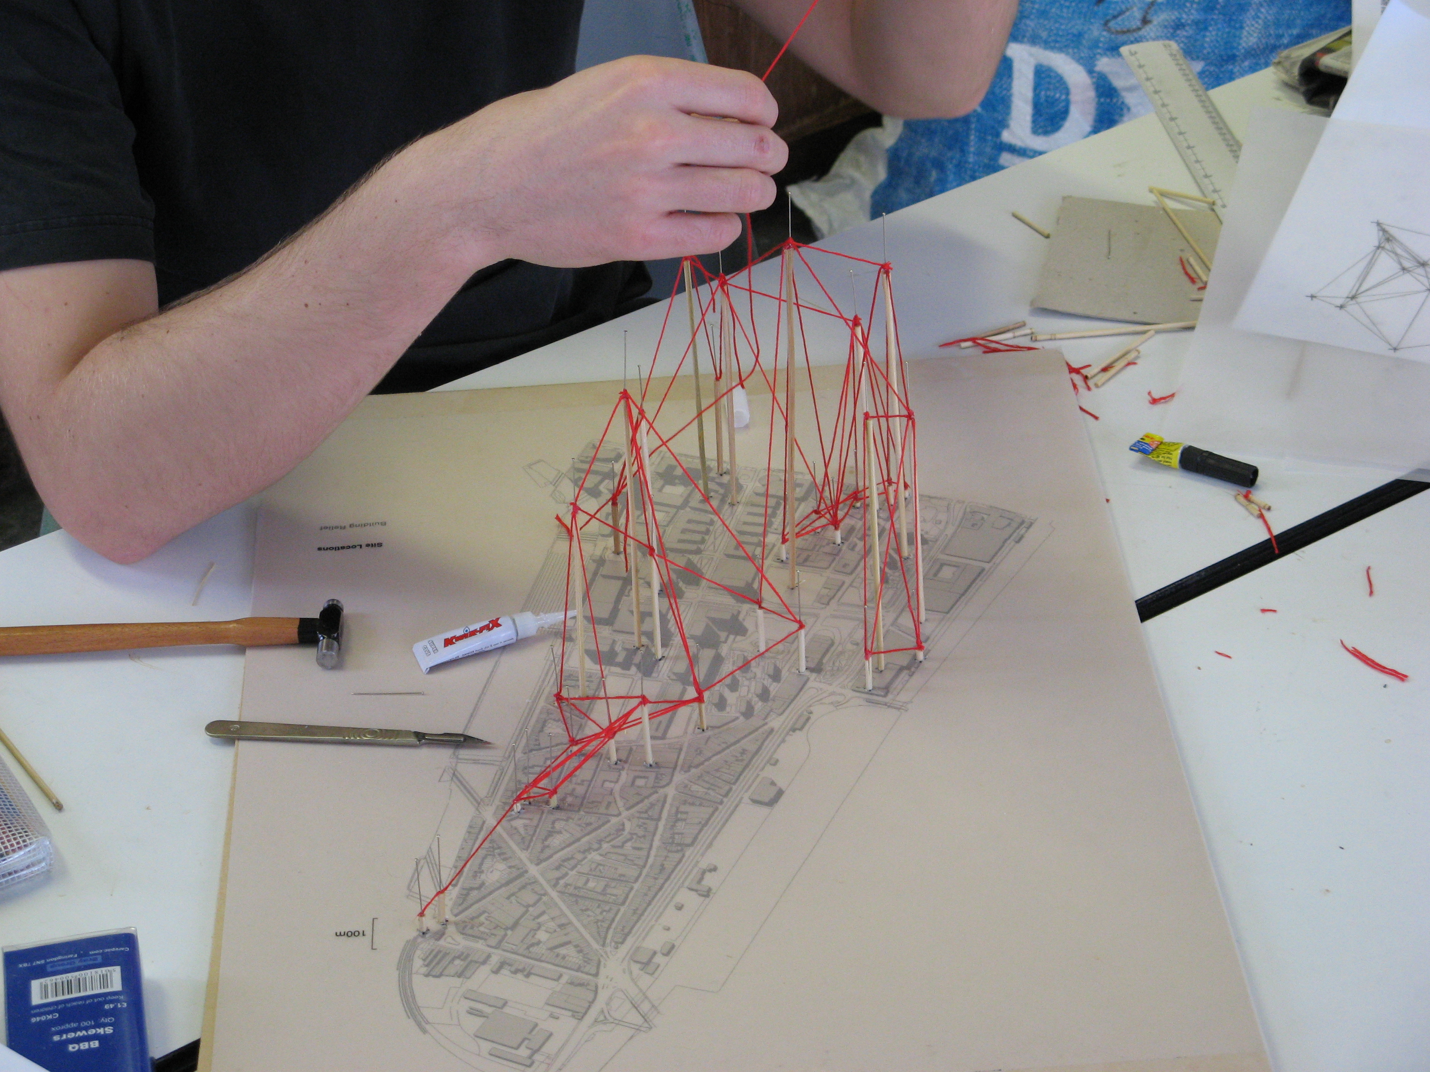
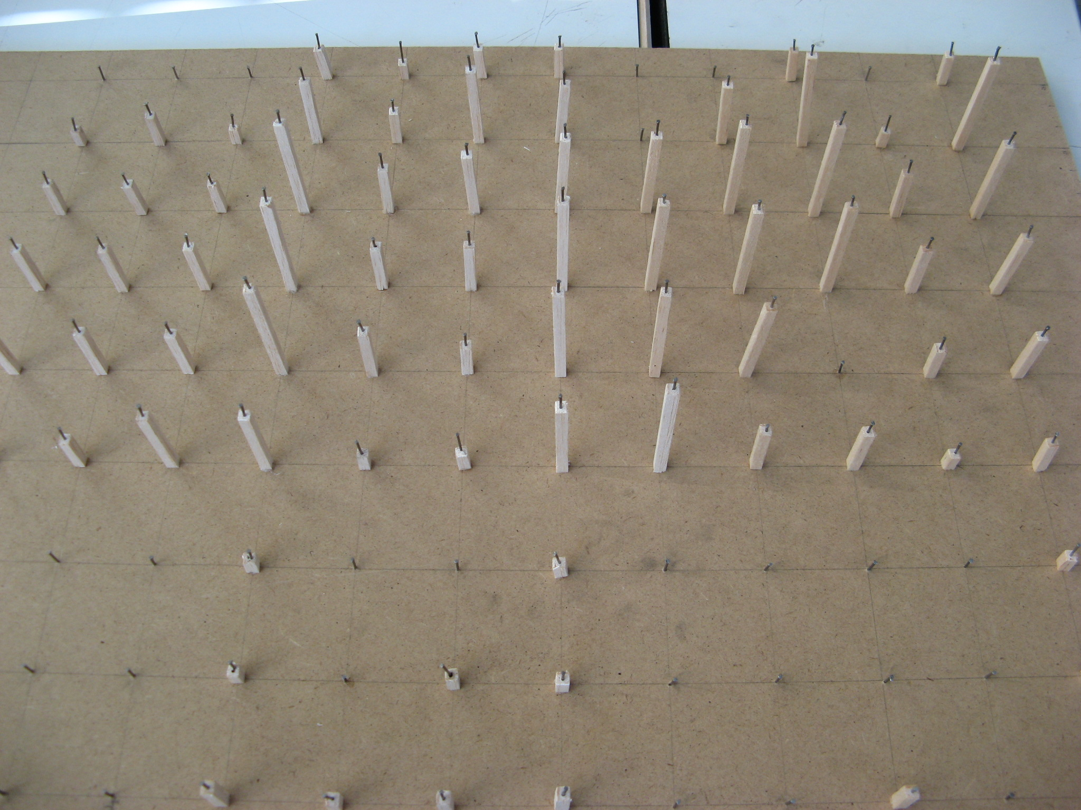

Slide 5
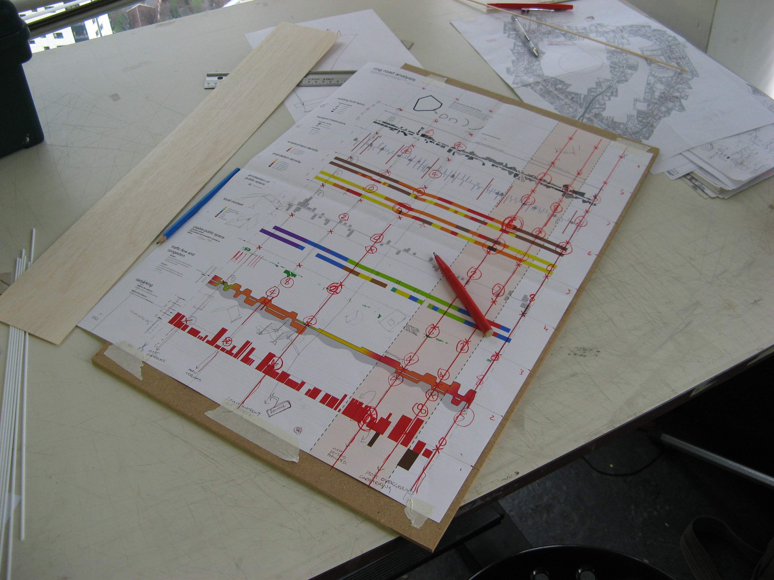
#Select theme and combine parameters
#Normalise values
- - - - - - - - - - - - - - - - - - - - - - - - - - - - - - - - -
int parameter1 = random (0,2);
int parameter2 = random (0,2);
int parameter3 = random (0,2);
int parameter4 = random (0,2);

Slide 6
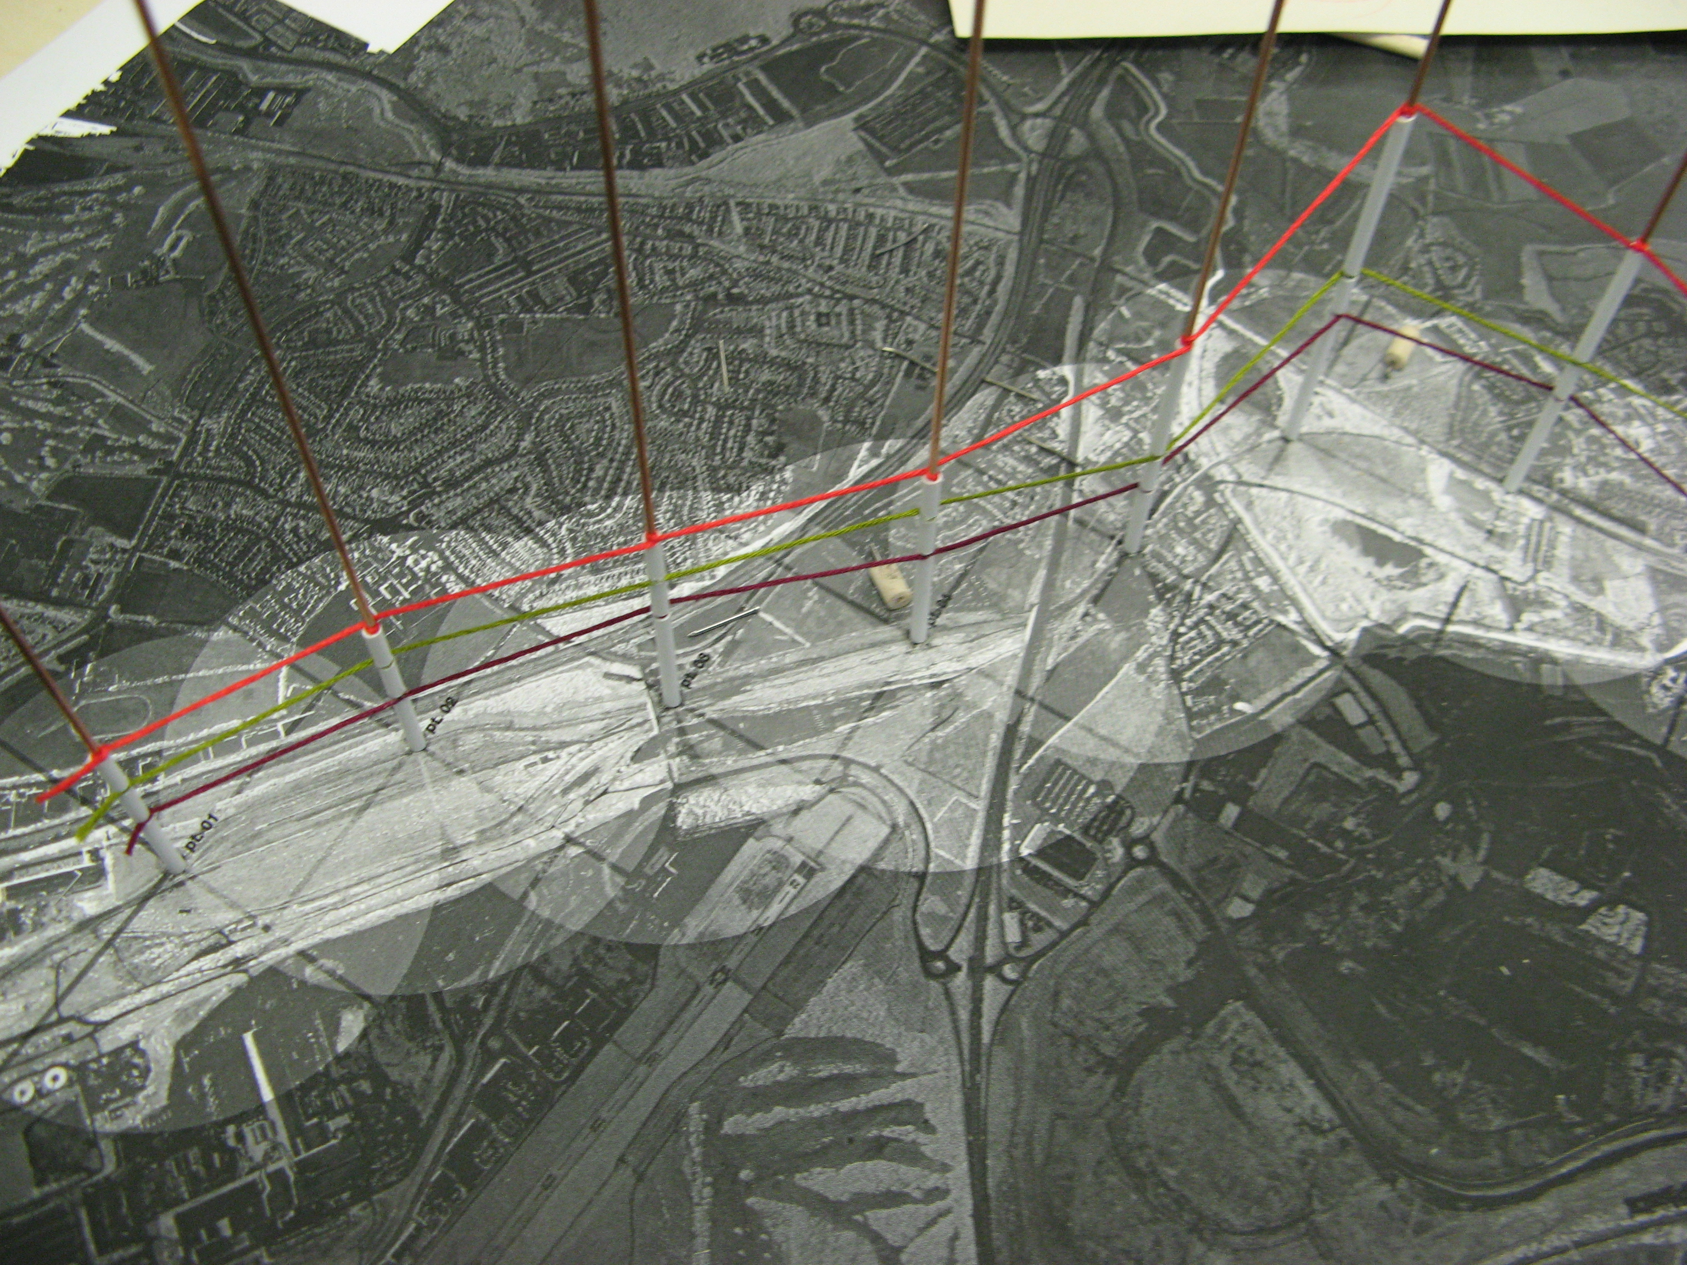
#Select 'geometric' condition
- - - - - - - - - - - - - - - - - - - - - - - - - - - - - - - - -
if (geomCond = = plan){
model = mesh;
}
if ( geomCond = = section){
model = mass;
}
if (geomCond = = elevation){
model = line;
}

Slide 7
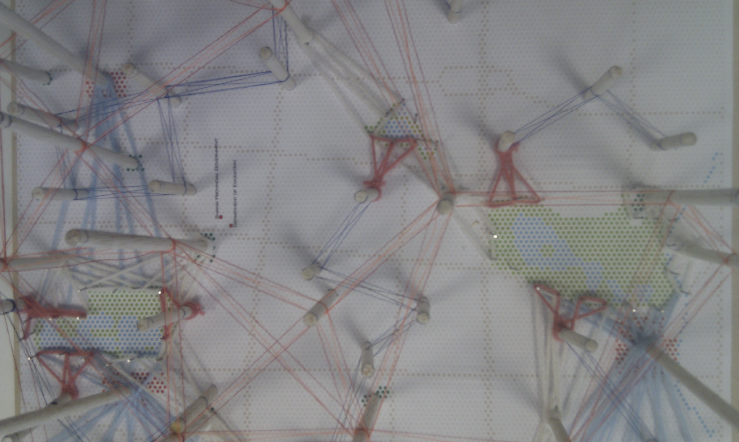
#Select topological condition
- - - - - - - - - - - - - - - - - - - - - - - - - - - - - - - - -
if (topology = = fixed){
field = deformation;
}
if ( topology = = dynamic){
field = relational;
}
#Determine code logic
- - - - - - - - - - - - - - - - - - - - - - - - - - - - - - - - -
if ( field = = deformation) {
logic = geometric;
}
if ( field = = relational) {
logic = conditional;
}

Slide 8
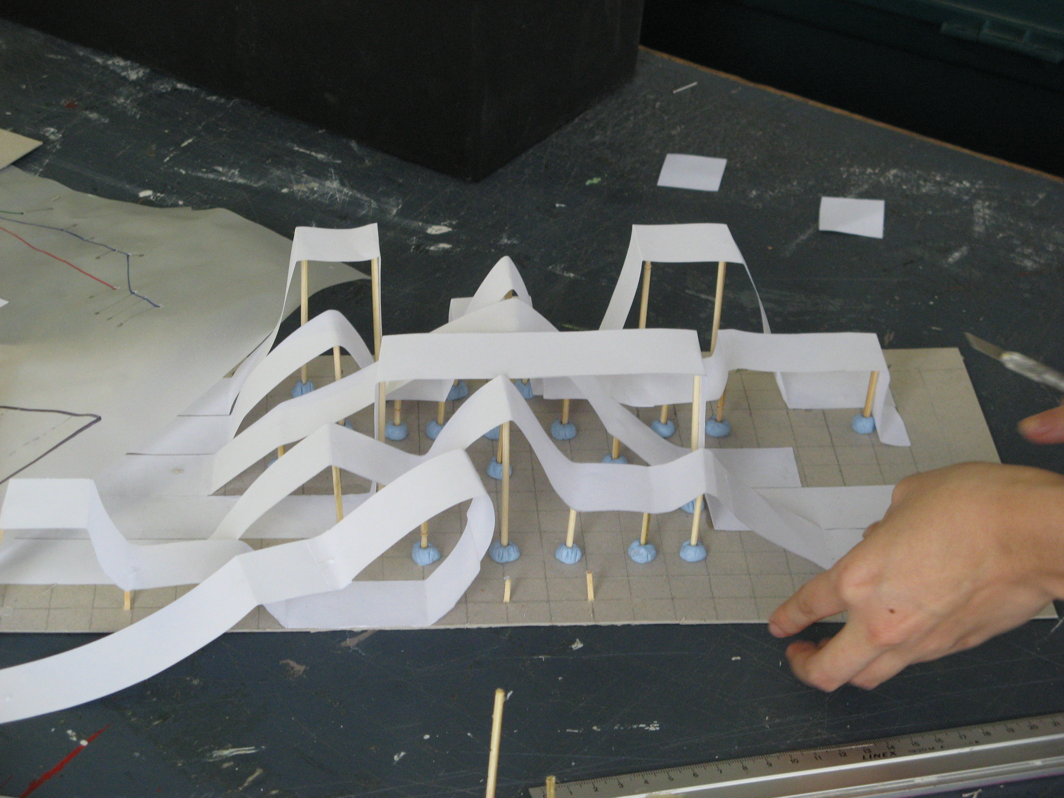
#Example loops for making physical models
- - - - - - - - - - - - - - - - - - - - - - - - - - - - - - - - -
If (string = = tooLong){
stringCut = true;
}
If (model = unstable)}
moreGlue = true;
}
if ( field = = relational) {
logic = conditional;
}

Slide 9
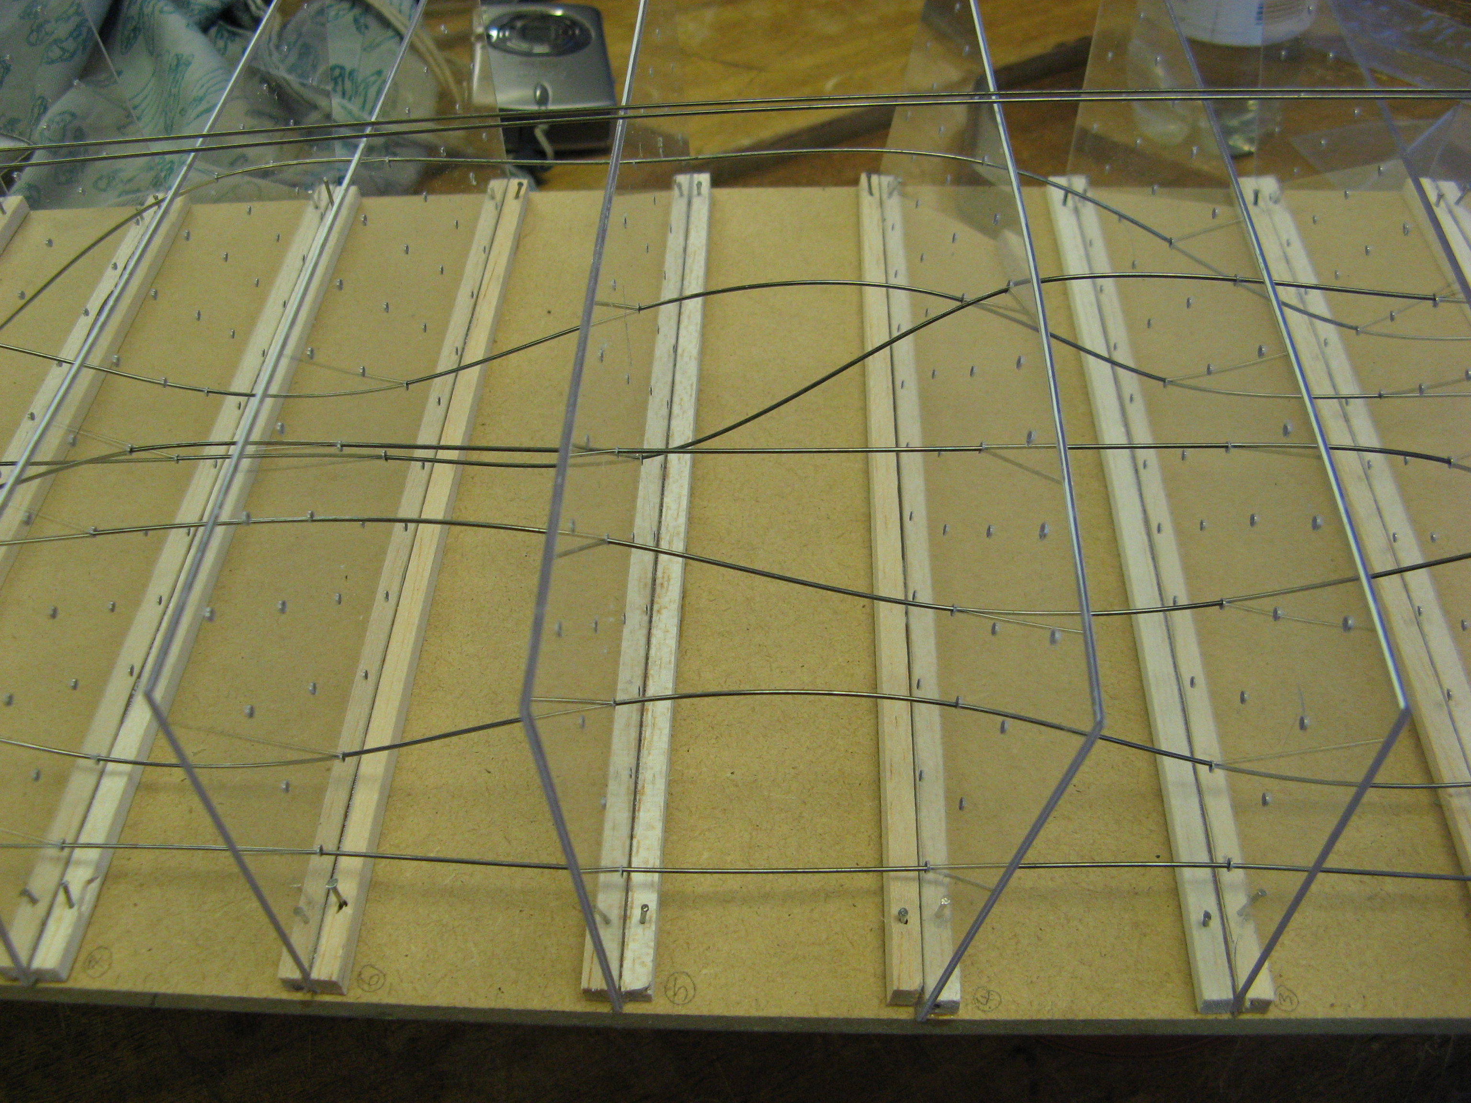
TACTILE PROGRAMMING:
'Material Computing' For Architectural Design
Students from School of Architecture, University of Sheffield

Slide 10
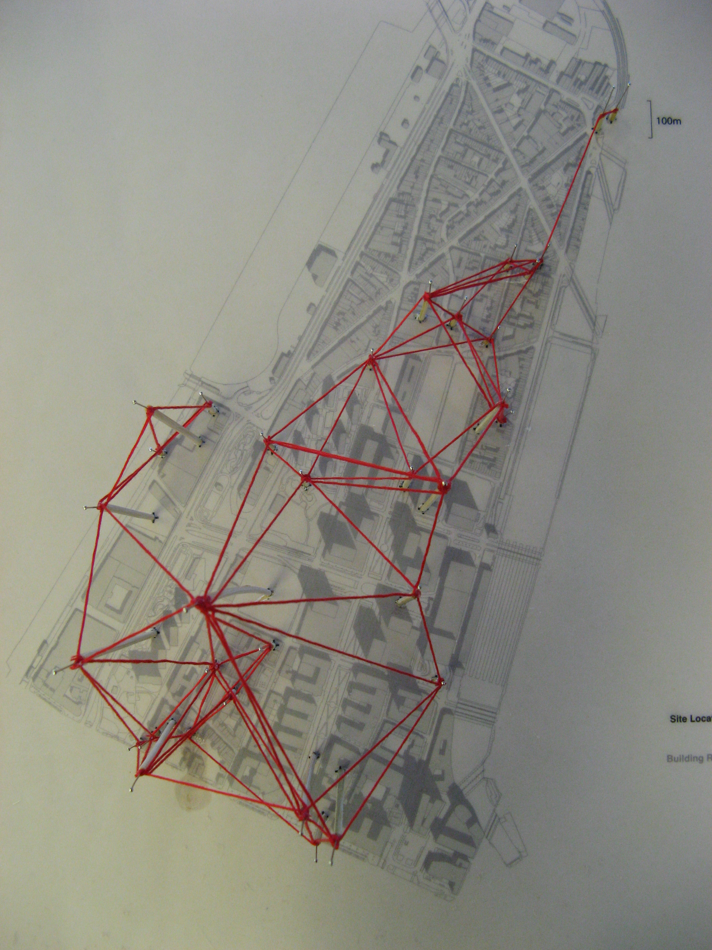
TACTILE PROGRAMMING:
'Material Computing' For Architectural Design
Students from School of Architecture, University of Sheffield

Slide 11
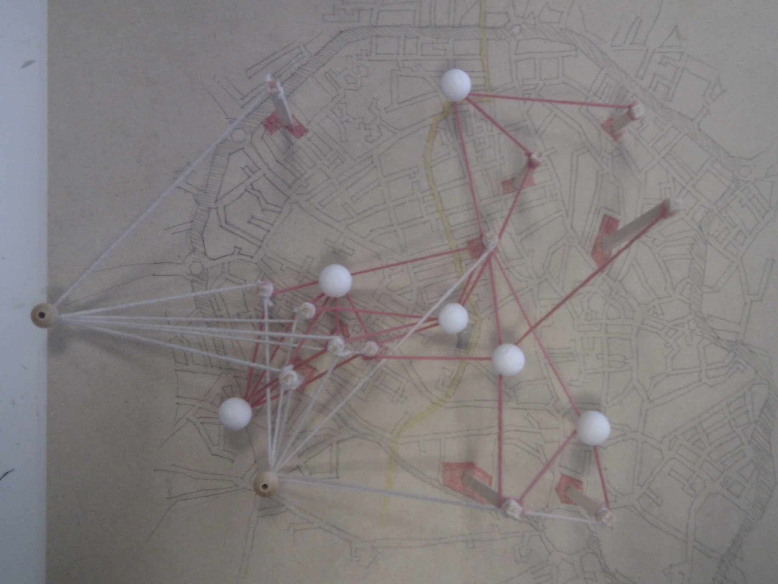
TACTILE PROGRAMMING:
'Material Computing' For Architectural Design
Students from School of Architecture, University of Sheffield

Slide 12
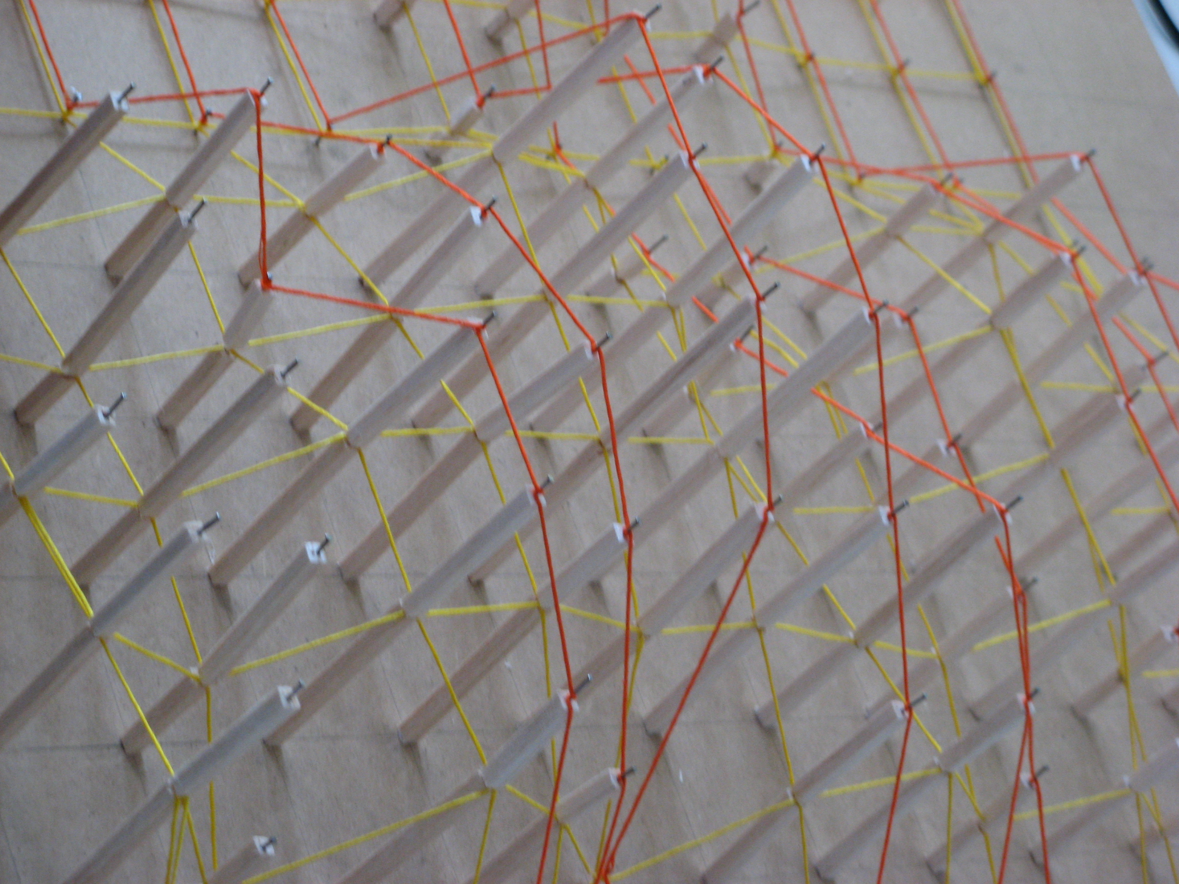
TACTILE PROGRAMMING:
'Material Computing' For Architectural Design
Students from School of Architecture, University of Sheffield

Slide 13
Algorithms as an explicit records of process
- - - - - - - - - - - - - - - - - - - - - - - - - - - - - - - - - - - - - - - - - -
Simulations as open experiments
- - - - - - - - - - - - - - - - - - - - - - - - - - - - - - - - - - - - - - - - - -
Interfaces as models of involvement

